Slide 1
BASKETBALL COURT DESIGN
Team Members:
Adel Alnasser
Daij Alfahad
Hamad Alqalaf

Slide 2
Overview
Project Understanding
Project List of Tasks
Task Testing and Analysis
Project Costs
Final Design

Slide 3


Stakeholders, Client and Technical Advisor
http://www.hoamco.com/
http://www.research.nau.edu/newsletter/spring2011/aztrans.aspx
Stakeholder:
Homeowner Association Management Company
http://nau.edu/CEFNS/Engineering/CivilEnvironmental/Directory/Lamer/
Client: Dr. Edward Smaglik
Technical Advisor: Mr. Mark Lamer

Slide 4
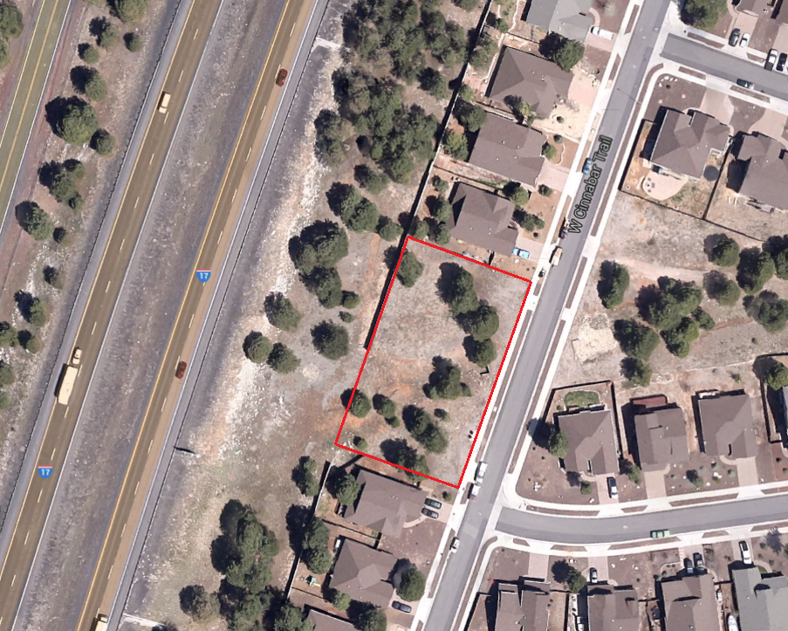
Project Description
Designing a full basketball court with maintaining the existing drainage system.
Location:
Ponderosa trails unit eight.
Area of the empty land is:
0.57 Acres
Taken from Google Maps

Slide 5
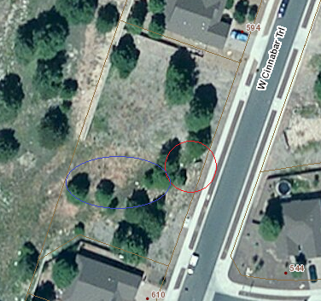
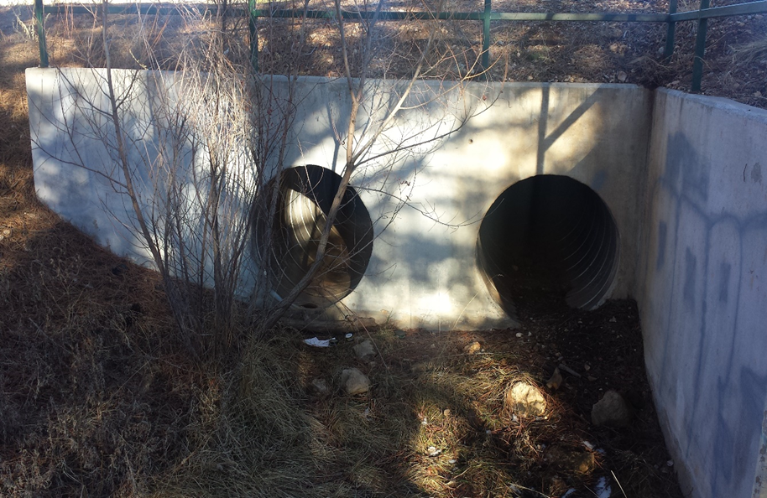
Current Conditions
The land is located by interstate I-17
Existing sub-basin approximately 1/3 of the total area
Two barrel circular culverts
Trees on the way of the proposed design
Sided by houses
No parking spots
https://gismaps.coconino.az.gov/ParcelViewer/
Taken by Daij

Slide 6
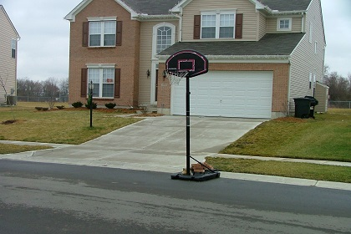
Purpose of The Project
Developing the site.
Make use of the empty land to become a basketball court.
Meeting the residents’ satisfaction and the community.
http://www.miamitownship.com/182/Basketball-Hoop-Policy

Slide 7
Project List of Tasks
Task 1: Project Management
Task 2: Data Collection
Task 3: Surveying
Task 4: Drainage
Task 5: Additional Features
Task 6: Final Design

Slide 8
Data Collection
  Policies, regulations and information research.
    Ponderosa Trails Unit Eight Construction Plans and Drainage Report done by Woodson Engineering and Surveying, Inc.
    Flagstaff City Code, Title 10 and 13, Flagstaff Zoning Code and Engineering Design Standards and Specifications for New Infrastructure.
    Detention Basin Requirements - City Of Flagstaff Stormwater Design Manual (Ch.8)
    Low Impact Development - Guidance Manual for Site Design and Implementation
    Maricopa Association of Governments

Slide 9

Surveying
Total station and data collector were used to shoot 276 points.
Auto level and measuring tape were used to determine the existing culvert dimensions, elevation and slope.
Parameters | Culvert 1 | Culvert 2
Diameter (ft) | 3 | 3
Length (ft) | 80.65 | 80.65
Slope (ft/ft) | 0.0005 | 0.0006
Points Layout from AutoCAD

Slide 10
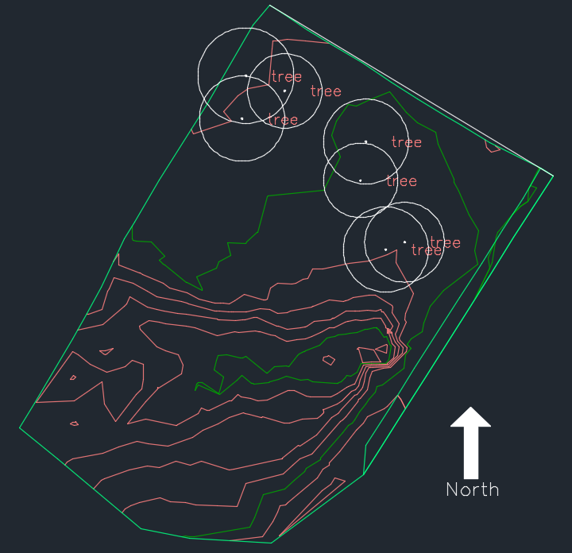
Topographic map
The surveying points were used to create the map.
Determining the trees’ location.

Slide 11
Drainage (Hydrology)
NOAA Atlas 14 Data:
Precipitation Frequency (in/hr)
by duration | 2 years | 10 years | 100 years
5-min: | 3.54 | 5.78 | 9.77
10-min: | 2.69 | 4.4 | 7.44
15-min: | 2.23 | 3.64 | 6.15
30-min: | 1.5 | 2.45 | 4.14
60-min: | 0.93 | 1.51 | 2.56
2-hr: | 0.53 | 0.83 | 1.39
3-hr: | 0.38 | 0.58 | 0.95
6-hr: | 0.23 | 0.33 | 0.51
12-hr: | 0.14 | 0.2 | 0.29
24-hr: | 0.1 | 0.14 | 0.21

Slide 12

Drainage (Hydrology)
Rational Equation
Q = C I A
Where:
Q is Discharge (cfs)
C is Runoff Coefficient
I is Intensity (in/hr)
A is Area (Acres)
$C$-bar = $\frac{\sum{C A } }{A_{total}}$
Sheet Flow Equation
  T = $\frac{0.007 {(nl)}^{0.8} }{P^{0.5} {(s)}^{0.4}}$
  Where:
  T is Sheet Flow Travel Time (hr)
  n is Manning’s Roughness Coefficient
  L is Flow Length (ft)
  P is Year 24 hours Precipitation (in)
  S is Slope (ft/ft)

Slide 13
Drainage (Hydrology)
Pre-Development
 | Pervious | Impervious
Area (Acre) | 0.570 | 0.000 |  | Total Area = | 0.570
C | 0.5 | 0.95 |  | C-bar = | 0.500
Tc (min) | 5 | 5
2 years | Area (Acre) | Tc (min) | Intensity in/hr | C | Q (Cfs)
Total A | 0.570 | 5 | 3.540 | 0.500 | 1.0089
10 years | Area (Acre) | Tc (min) | Intensity in/hr | C | Q (Cfs)
Total A | 0.570 | 5 | 5.78 | 0.500 | 1.6473
100 years | Area (Acre) | Tc (min) | Intensity in/hr | C | Q (Cfs)
Total A | 0.570 | 5 | 9.77 | 0.500 | 2.78445
Post-Development
 | Pervious | Impervious
Area (Acre) | 0.490 | 0.080 |  | Total Area = | 0.570
C | 0.5 | 0.95 |  | C-bar = | 0.563
Tc (min) | 5 | 5
2 years | Area (Acre) | Tc (min) | Intensity in/hr | C | Q (Cfs)
Total A | 0.570 | 5 | 3.540 | 0.563 | 1.13634
10 years | Area (Acre) | Tc (min) | Intensity in/hr | C | Q (Cfs)
Total A | 0.570 | 5 | 5.78 | 0.563 | 1.85538
100 years | Area (Acre) | Tc (min) | Intensity in/hr | C | Q (Cfs)
Total A | 0.570 | 5 | 9.77 | 0.563 | 3.13617
ΔQ_{max}= 0.35 cfs

Slide 14
Drainage (Hydrology)
Storage Volume “Acre-ft” | Storage Volume “ft^{3”}
0.012 | 506

Slide 15
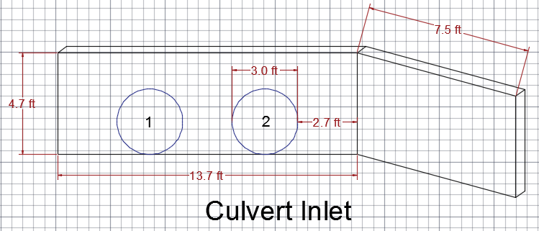
Hydraulics
The Peak Discharge Year | Hydrologic Element | Discharge Peak (Cfs) | Volume (ac-ft) | Area (mi²)
10-Year | Sub-Basin 15a | 9.5895 | 2.2996 | 0.180
25-Year | Sub-Basin 15a | 29.857 | 4.7718 | 0.180
100-Year | Sub-Basin 15a | 67.468 | 8.7316 | 0.180
Existing Culverts Analysis:
Based on the Pre-development discharge data and culvert dimensions.
Woodson Engineering Drainage Report
Maximum Capacity Q= 73.6 cfs

Slide 16
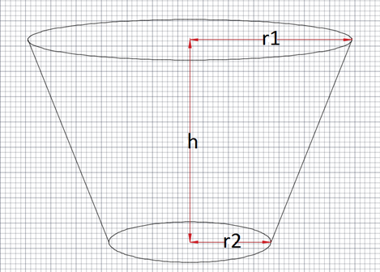
Hydraulics
Detention Basin Design
Basin Design Dimensions Including Freeboard
r₁ ₍ft) | 13.31
r₂ (ft) | 5.81
H (ft) | 2.5
V (ft³) | 754.62
Water Level
Storm Event (years) | Volume (ft³) | Water level (ft)
2 | 183.28 | 1.05
10 | 296.20 | 1.45
100 | 506.00 | 2.00
Required slope: 3:1
Required Freeboard: 0.5 ft
Maximum unprotected depth: 3 ft

Slide 17
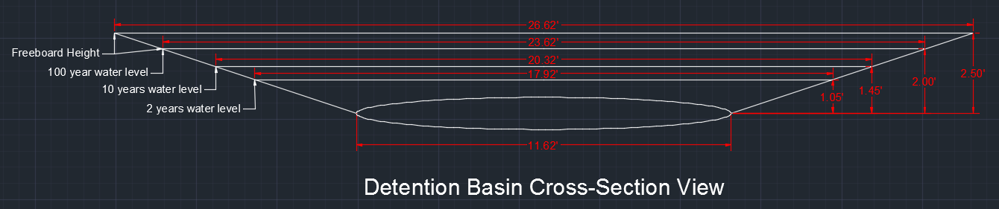
Hydraulics
Side Slope =3:1

Slide 18
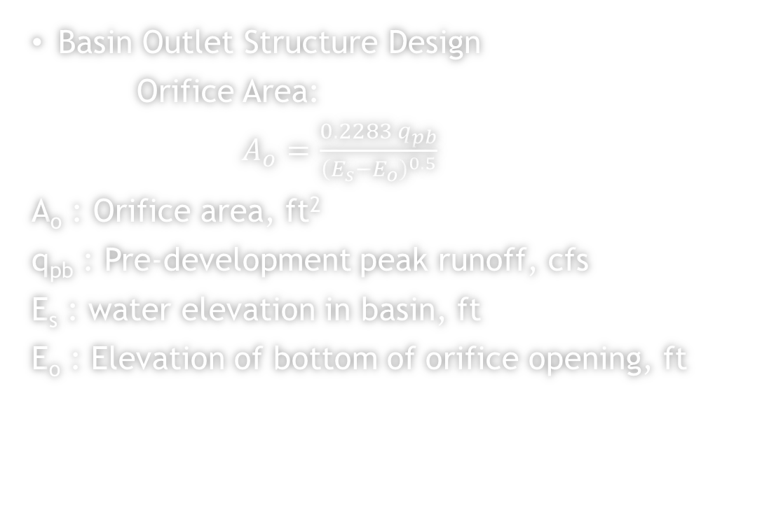
Hydraulics
Basin Outlet Structure Design
Orifice Area:
$A_{o}=\frac{0.2283 q_{pb}}{{\left(E_{s}−E_{o}\right)}^{0.5}}$
A_{o} : Orifice area, ft²
q_{pb} : Pre-development peak runoff, cfs
E_{s} : water elevation in basin, ft
E_{o} : Elevation of bottom of orifice opening, ft
Storm Event (Years) | A_{o} (ft²)
2 | 0.25
10 | 0.35
100 | 0.26

Slide 19
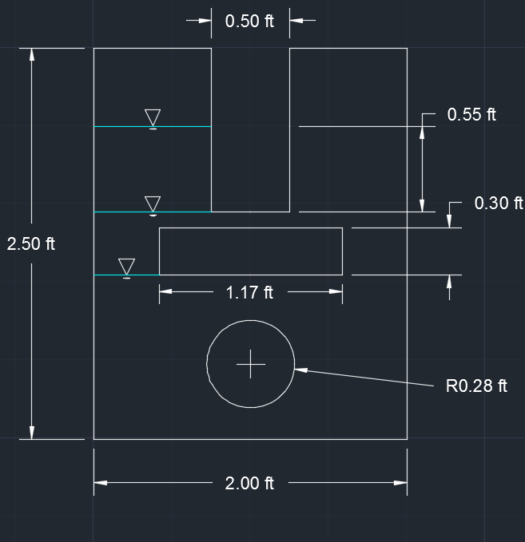
Hydraulics
Outlet wall structure

Slide 20
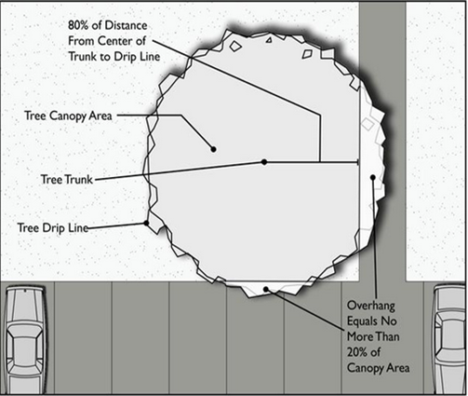
Additional Features
Resource Protection:
  The calculation of the trees drip line to avoid any root damage.
  Diameter at Breast Height (DBH) was measured to determine the canopy area.
  Based on the resource protection calculations:
    4 trees need to be cut.
Flagstaff Zoning Code, Title 10

Slide 21
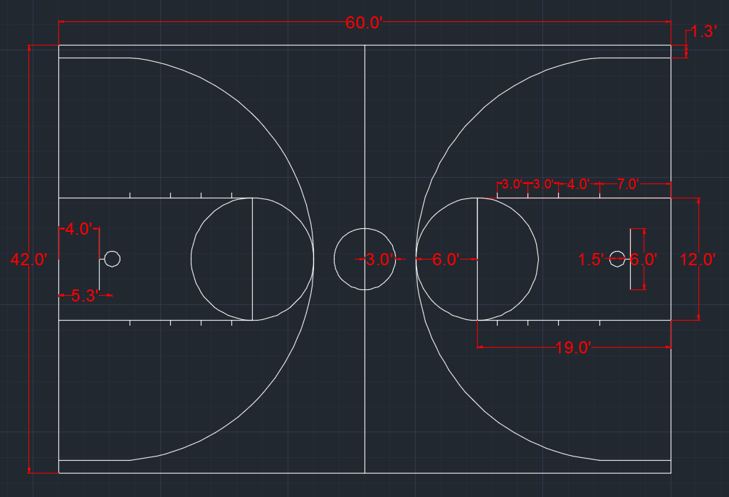
Additional Features
Court Dimensions:
  There will be additional 2 ft on both the length and the width of the court.
  Minimum slope corner to corner= 0.8 percent.
  The concrete that will be used for the court is the same as the sidewalk structure.

Slide 22
Additional Features
Sidewalk: According to City of Flagstaff and Maricopa Association of Governments (MAG):
Width= 5 ft
Thickness= 4 in
Slope= 1.5%
Radius at Edges= 0.25 in
Class A Portland cement concrete containing 5 to 7 percent air entrainment.
According to (MAG) detail 230, the construction joints score mark is 1/2 inch minimum depth every 5 ft.
According to (MAG) section 340 the expansion joints extent through the concrete and 1 inch through the subgrade.

Slide 23

Additional Features
The Project meets the standards for accessible design (ADA)
Low Impact Development is not required.
Bench area will have two 8 ft long benches on one side of the court.
  The Pavement Area= 20ftx3ft= 60 ft²
Traffic Analysis:
  Installing “No parking” signage
http://commons.wikimedia.org/wiki/File:Singapore_Road_Signs_-_Restrictive_Sign_-_No_Parking.svg

Slide 24
Costs Analysis
Total Cost of Engineering Services and Implementation
Engineering Services | $ 28680
Implementation | $ 13250.55
Total Cost | $ 41930.55

Slide 25
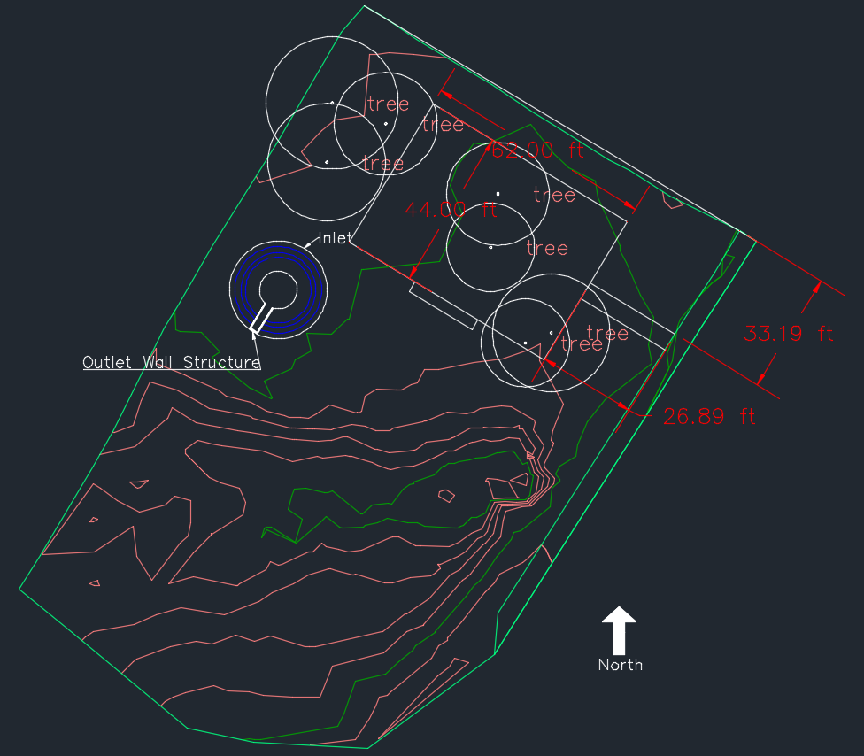
Final Design

Slide 26
Questions ?

